Slide 1

Orderista
Group No. 17
Members
Tejas Raibagi-17104067
Ashwin Vishwakarma-17104009
Jahnavi Naik-17104046
Project Guide and Coguide
Mrs. Rujata Chaudhari
Mrs. Geetanjali Kalme

Slide 2
Contents
Introduction
Objectives
Problem Definition
Technological Stack
Review Suggestions
Proposed System Architecture/Working
Prototype Design Demonstration
Plan of Paper Publication

Slide 3
Introduction
In today's age of automation, still many canteens are seen to be utilising manual work causing a lot of incasualities.
By bringing all the necessities in one place canteen automation system benefits both the user as well as the canteen smartly. Ultimately all operations will be made easier and single handed.
Using the application, students can either collect their ordered food from the canteen and have it or they could collect parcels from specific pickup locations because of which less space in canteen would not be an issue any more.
When the student visits the page they are presented with an interactive and up-to-date menu.
This system also greatly lightens the load on the canteens end, as the entire process of taking orders and serving is automated.

Slide 4
Objectives
To make it convenient for those who have less time.
To allow users to give their orders before hand makes them save time and enables them to eat wherever they like.
To minimise the need to look for space in canteen to have a seat, one could add a pickup location location for their delivery making it to go with some ease.
To avoid complications of cash or inaccurate service.
To save time would be one of the major objective out here.
To make it cost effective as online transactions are just more secure.
To reduce paperwork or manual work.

Slide 5
Problem Definition
Problem Identified
The main challenge encountered by our college is that of space being a little less to accommodate all the students at the same time. The experience of ordering food is not quick and a lot of complications while receiving the order. Manual system involves paper work in the form of taking orders maintaining cash which is full of risk and tedious process.
Solution
So this application not only is helping for canteen automation but also solves all of these concerns and makes a lot more easier and feasible atmosphere for every student as well as the manager. Every student will be able to access via their moodle id and a user generated password, by using which they can log into the system.

Slide 6
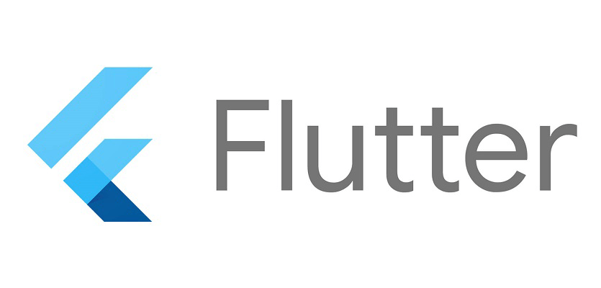


Technology Stack
Flutter is an open-source UI software development kit created by Google. It is used to develop applications for Android, iOS, Linux, Mac, Windows, Google Fuchsia, and the web from a single codebase.
Node.js is an open-source, cross-platform, back-end, JavaScript runtime environment that executes JavaScript code outside a web browser.
PostgreSQL, also known as Postgres, is a free and open-source relational database management system emphasizing extensibility and SQL compliance.

Slide 7
Review suggestions
QR code scanner and UPI for payment
Reports to be generated of all the activities daily/weekly/monthly
Data to be stored on cloud
Registration will be done via all possible modes eg.moodle id,faculty user id’s, google, phone and number.
To add a Feedback page

Slide 8
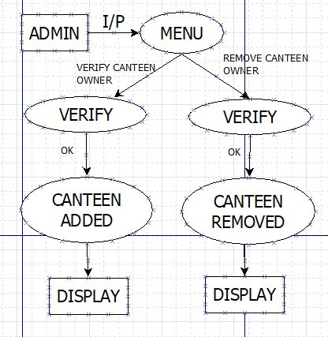
Proposed System Architecture
-- Admin

Slide 9
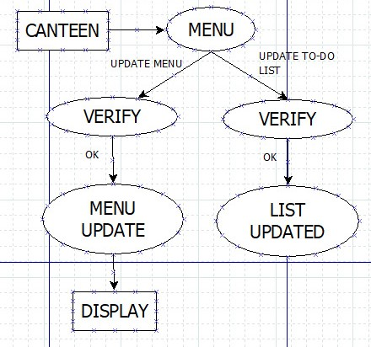
Proposed System Architecture
-- Canteen

Slide 10
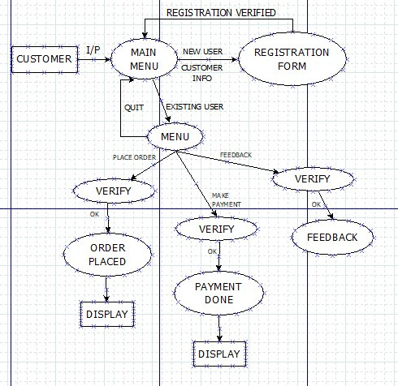
Proposed System Architecture
-- Users: Student/Faculty

Slide 11
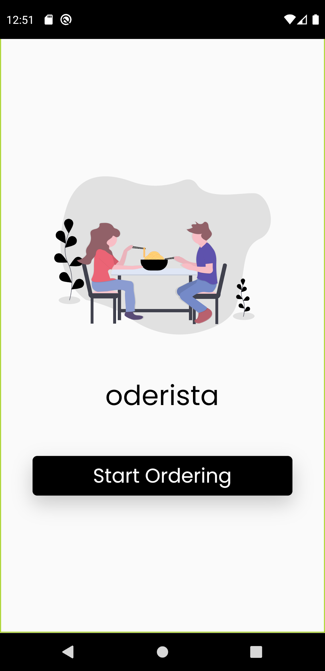
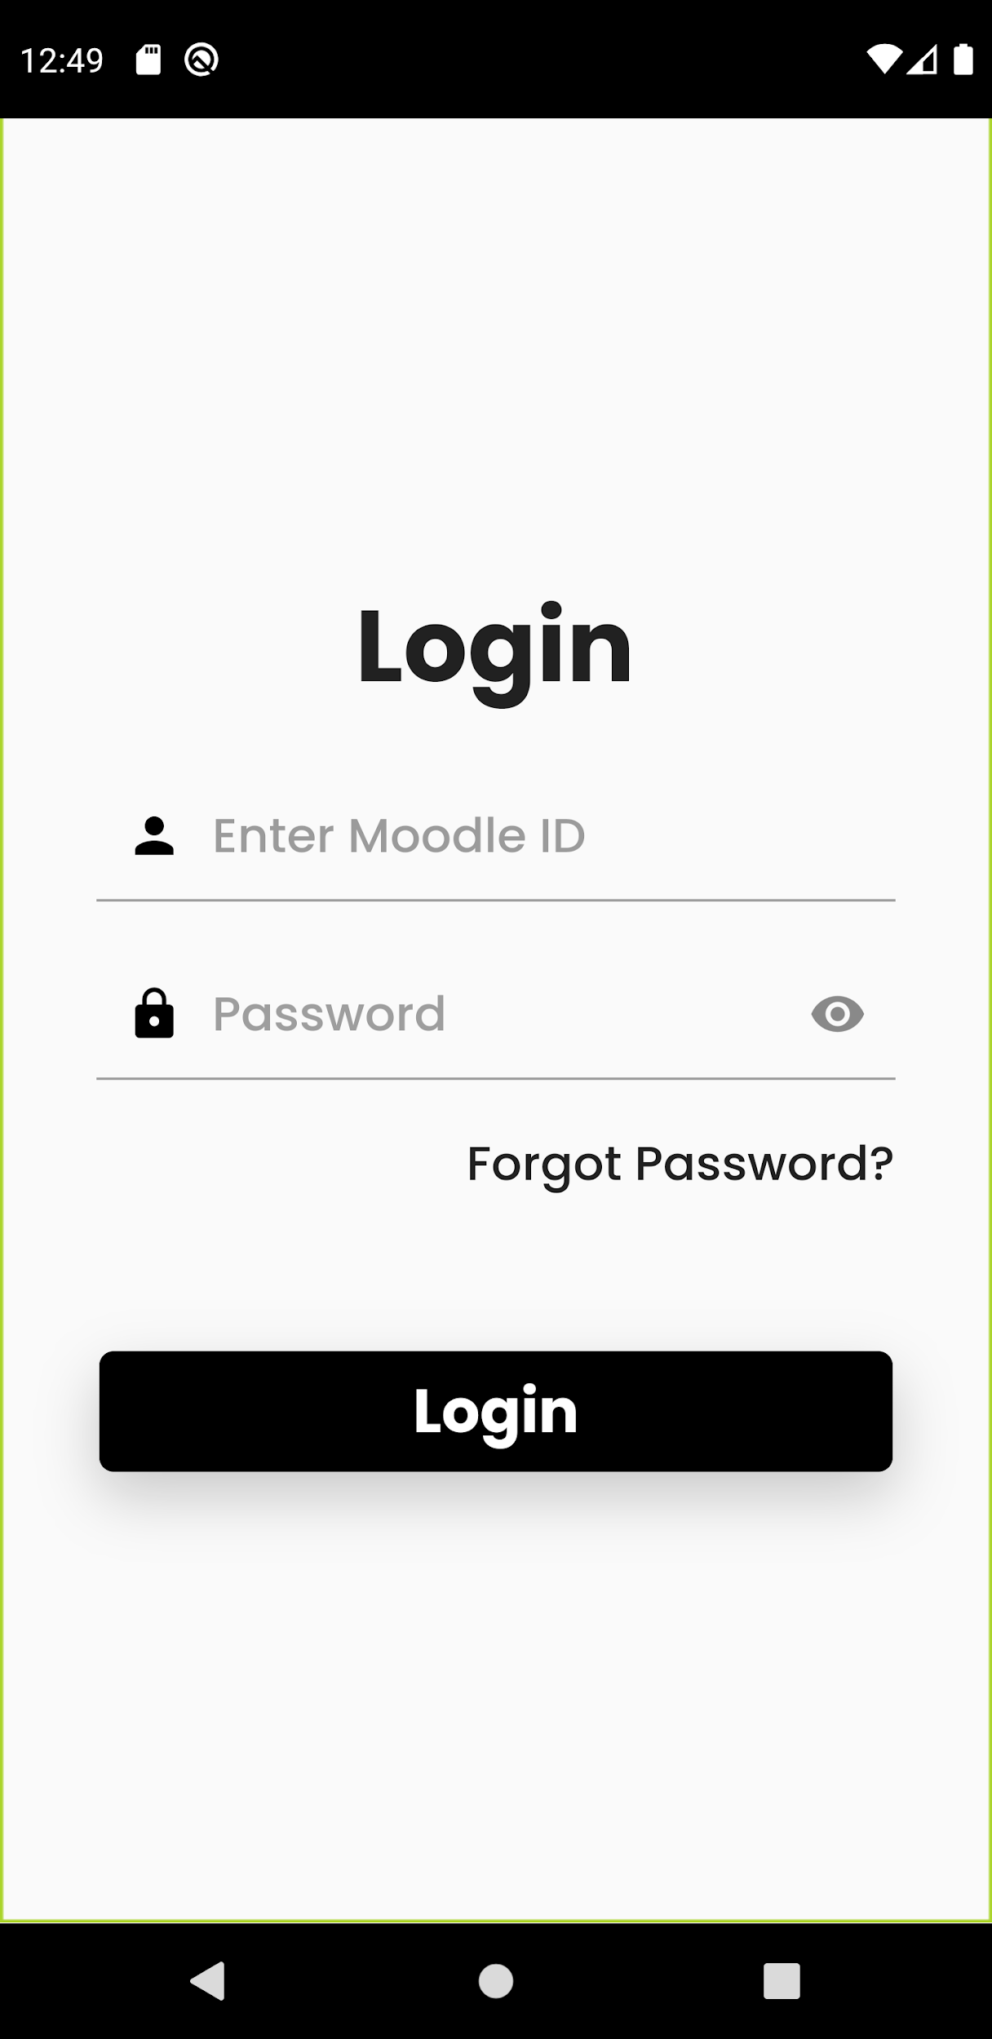
Prototype Design Demonstration

Slide 12
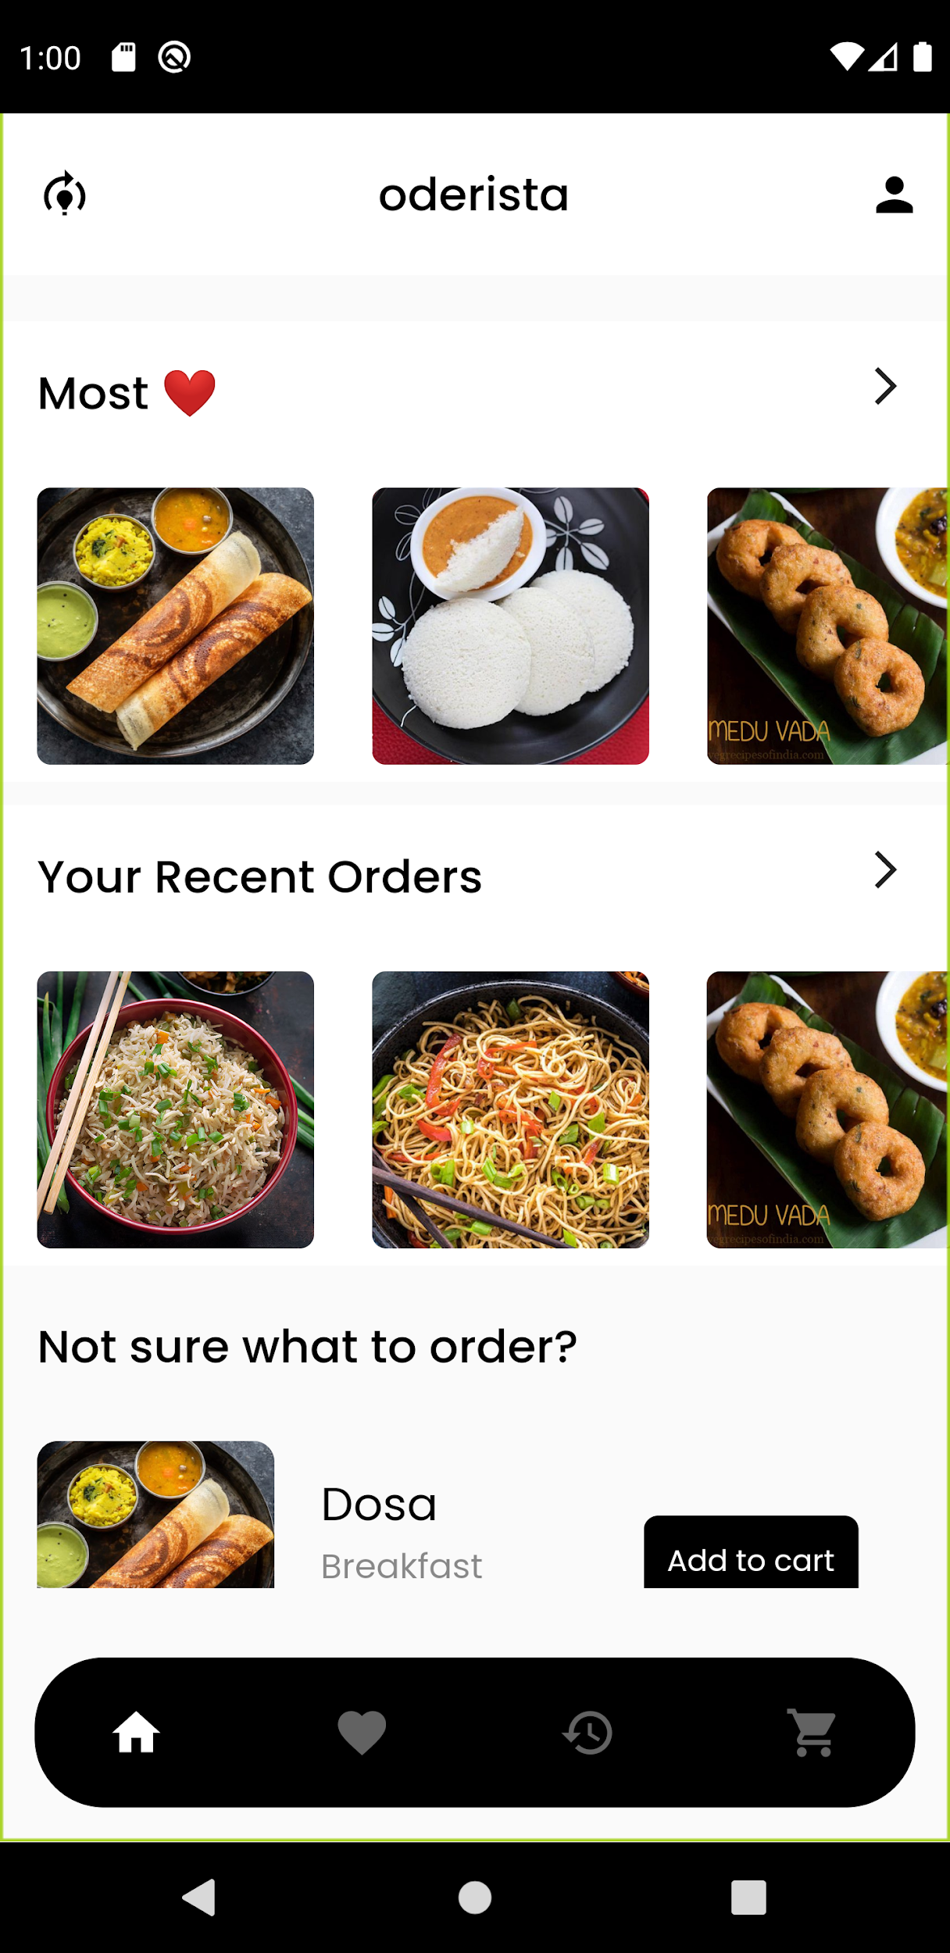
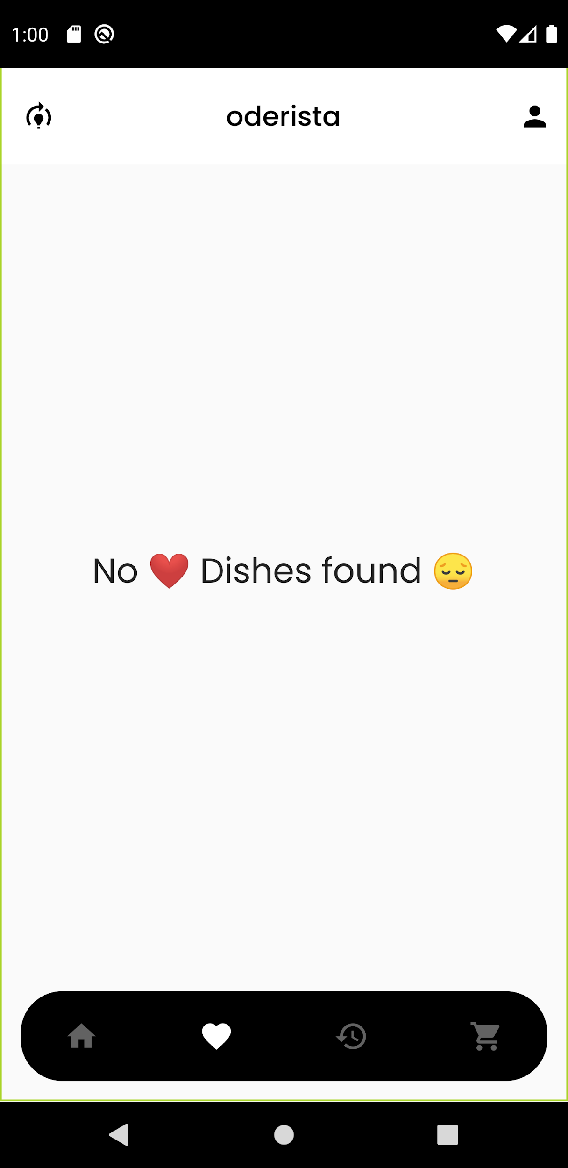
Prototype Design Demonstration

Slide 13
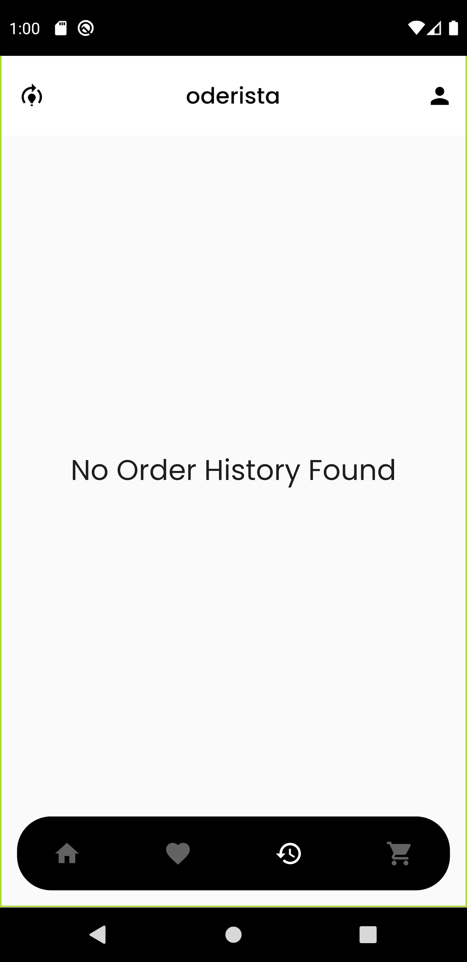
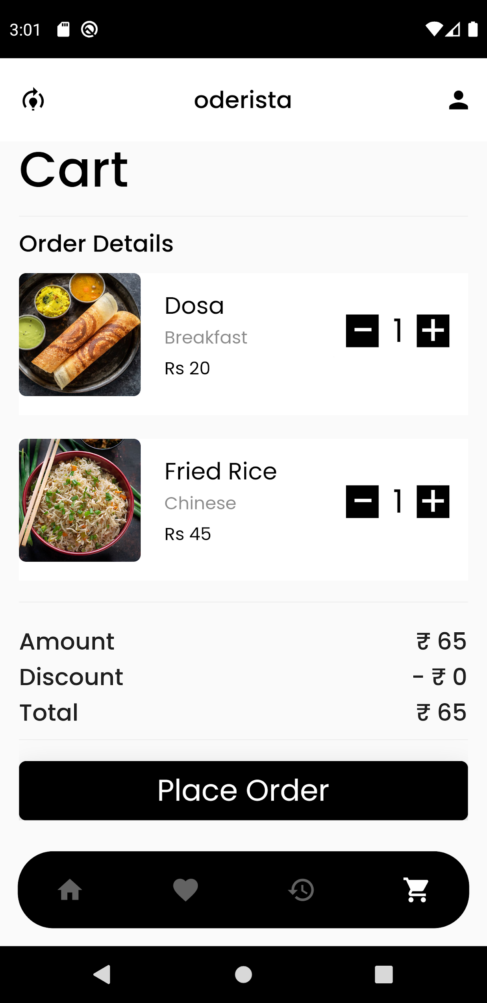
Prototype Design Demonstration

Slide 14
Plan for Paper Publication
25th International Conference on Information Technology (IT)
Conference dates: 16 - 20 February 2021
Call for Papers Deadline: 31 December 2020

Slide 15
Thank you!

